Slide 1
Problem-based AP® CS Principles
Part of a problem-based K-12 pathway
Bennett Brown, Project Lead The Way
Maurine Neiman, University of Iowa
Scott Sanicki, GitHub

Slide 2
Problem-based AP® CS Principles
Part I: Problem-based learning (15 min)
Part II: Game theory simulation (70 min)
Break (10 min)
Part III: Genomic data (65 min)
Q&A (10 min)

Slide 3
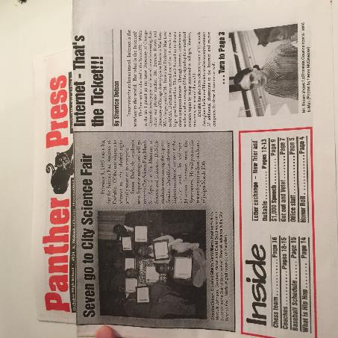
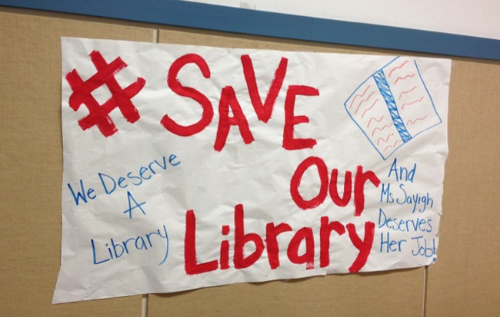
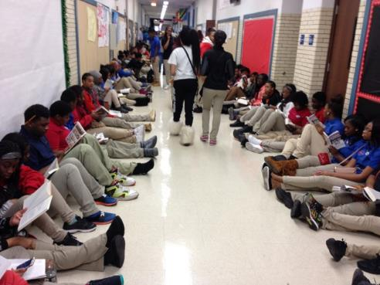
CS Principles: Broaden Participation in CS

Slide 4
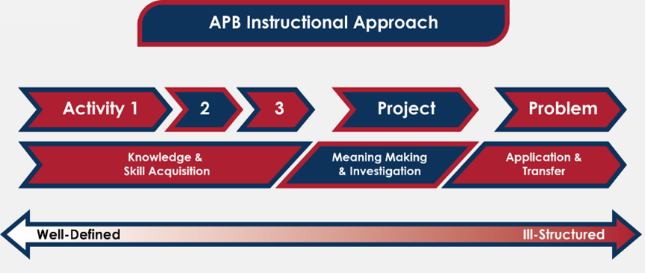
An activity-, project-, and problem-based lesson

Slide 5
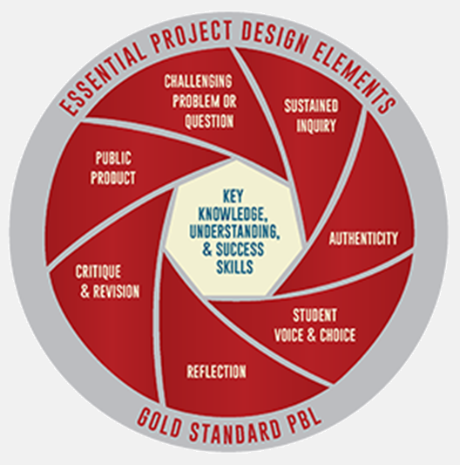

Design of problem-based learning (PBL)
©2015
Buck Institute
for Education
Notes:
Problems are selected so that students create evidence that demonstrates achievement of identified skills and knowledge. The Buck Institute for Problem-Based Learning describes gold-standard PBL using these criteria, with key knowledge and skills at the center. We follow the Understanding by Design model from Wiggins and McTighe: there should be a tight alignment between the desired results-skills and knowledge, the evidence students will produce, and the activity in class. If what we want is for students to apply computational thinking to solve real problems, then the course should have the students produce evidence of that transfer and application to problems they identify, and the learning scafold should be designed to produce that evidence.

Slide 6
K-12 computer science pathway
Elementary Schools: Launch Program
Middle Schools: Gateway Program
High Schools: Computer Science Program
Course Languages .
ICS Introduction to Computer Science MIT App Inventor + Python
CSP (AP) Computer Science Principles Python + broad exposure
CSA (AP) Computer Science A Java + Android SDK
4th year elective TBD; Cybersecurity piloting 2017-18
Notes:
Every lesson of our curricula are designed with this problem-based approach.
The Launch program includes four 10-hour modules for each grade level, with at least one of the 10-hour modules at each grade level focusing on computer science. Shay Pokress is presenting that material this afternoon at x:00 in room xxx.
In the middle school, the Gateway program provides 45-hour modules, many of which are designed to build computational thinking. Two of the 45-hour modules implement ICS for middle schools. Karine Laidley will be engaging workshop attendees with that content tomorrow at x:00 in room xxx.
Because many students still complete middle school without any computer science, our Introduction to Computer Science course is also offered as part of our high school program. ICS teaches students to solve real people’s problems, make real people’s lives better, by creating apps using MIT App Inventor. In that one semester course for grades 6-9, students also learn how sound and images are represented, how the web works, how to use proper cyberhygeine, how to use simulation, how to visualize data – the full range of computer science fundamentals addressed more deeply in Computer Science Principles.
In our CS Principles course, Python is the primary programming language, though our teachers use languages and tools appropriate for the task – NetLogo for simulation, and HTML/CSS/JavaScript/PHP/SQL for the web stack. We are one of the College Board endorsed curricula and professional development for CS Principles. Although we provide a pre-approved AP syllabus for the AP course audit, AP is in parentheses because schools are not required to offer the course as AP. PLTW provides an 80-minute end-of-course exam for every course, with articulation or dual enrollment options at 2- or 4-year postsecondary institutions under local agreements.

Slide 7
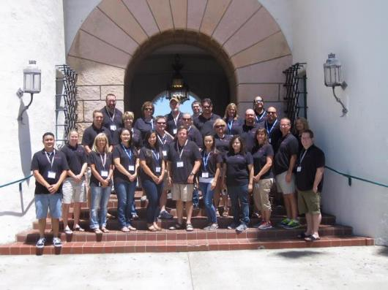
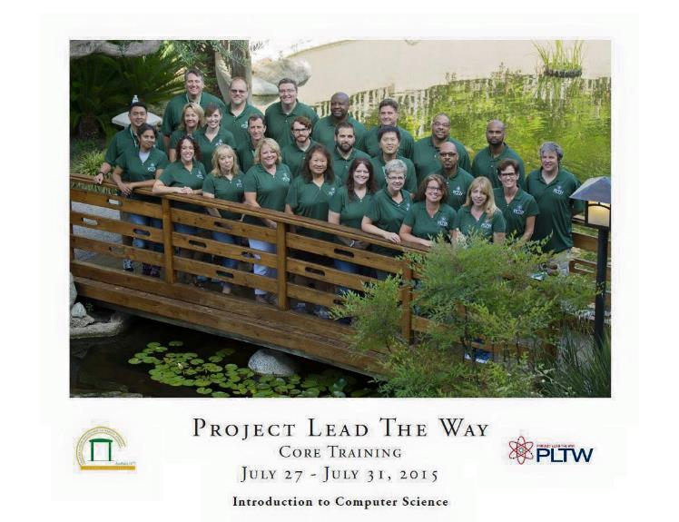
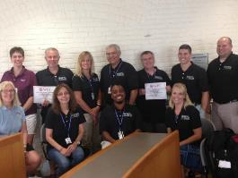
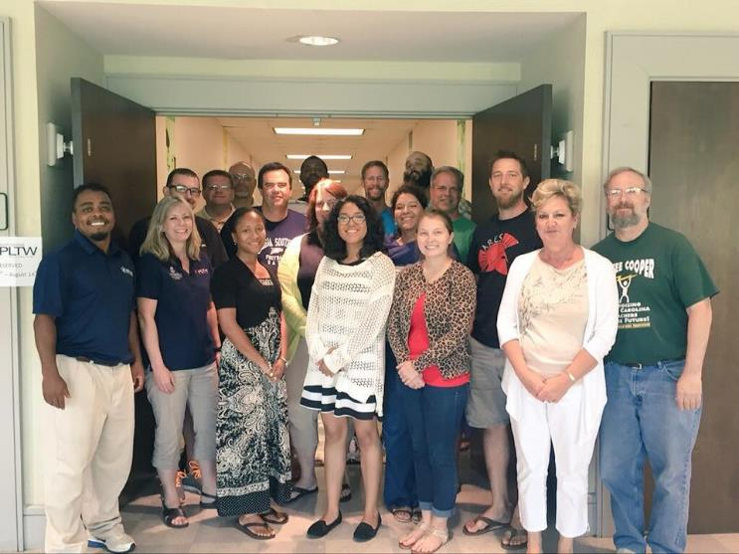
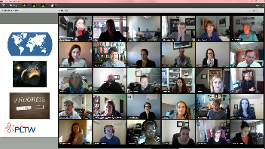
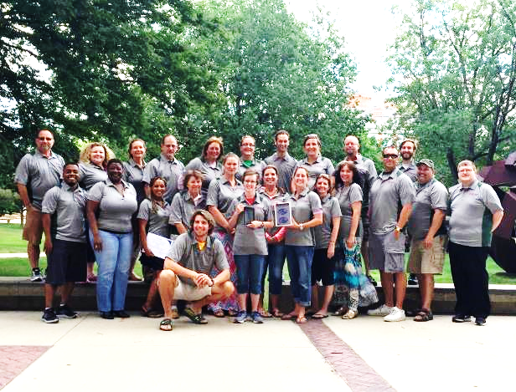
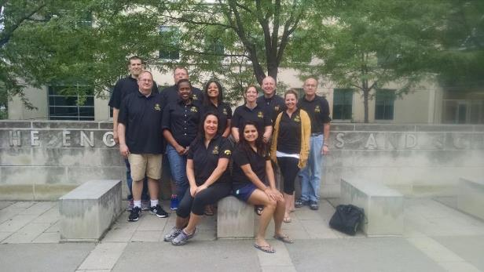
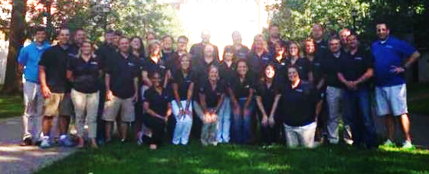
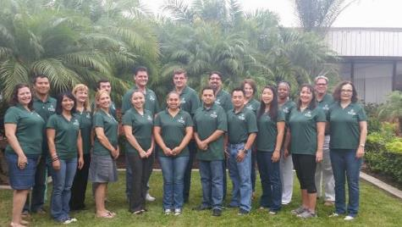
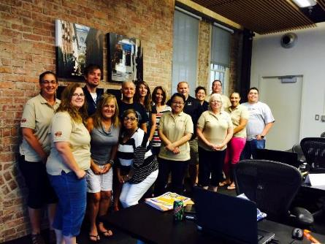
Professional Development

Slide 8
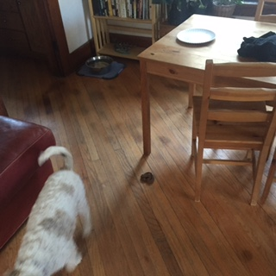

Why problem-based learning?
Notes:
Why problem-based learning? I’m going to have John Hattie summarize the research for you. In this book, Hattie synthesizes research on education and concludes we should make learning visible. That means place the objective-skills and knowledge-front and center, and provide steady streams of feedback between teacher and student about whether the objective is being achieved. Hattie examines 138 strategies for improving or reforming education and synthesizes the literature for each strategy.

Slide 9
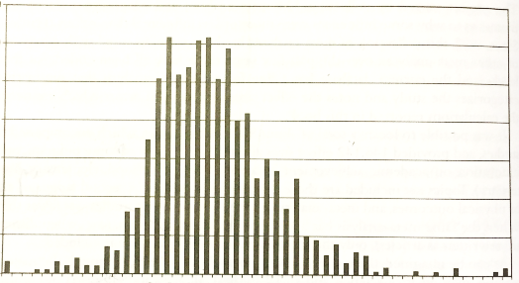
Effect sizes reported in 800 meta-analyses
Frequency of reported effect sizes
50 -
d = difference in means / std deviation
|
0
|
0.40
Effect size d
Notes:
The literature reports effects of various “things” you can do in education – emphasize vocabulary, teach reading strategies, integrate writing across the curriculum, and so on. Several dozen studies related to one strategy are published as a review of literature-a meta-analysis. The effect sizes reported in these metaanalyses are normally distributed. The median effect size is .30, and the standard deviation of the effect sizes is about 0.30. So what approaches in schools have the biggest impact?

Slide 10
John Hattie’s impact meter
d = difference in means / std deviation
# reports
50 -
0.4
0.2
Teacher
effects
|
0
|
0.40
d
0.0
Age
effects
Zone of
desired effects
Reverse
effects
-0.2
1.2
Notes:
Fopr visual impact, Hattie places all effects on a single meter and challenges us to focus on things we can do that actually make a difference in what students achieve.

Slide 11
Problem-based learning gets applied
PBL
# Meta-analyses | 8
# Studies | 285
# Effects | 546
# People | 38,090
Transfer
0.4
Attitude
Skills
0.2
Teacher
effects
Principles
0.0
Concepts
Zone of
desired effects
-0.2
1.2
Factoids
d
Notes:
Hattie summarizes the primary literature on problem-based learning. From 8 meta-analyses of studies on problem-based learning, there were 546 effect sizes from 285 studies. Each study reported a couple of effects, altogether measured across 38,000 students. Hattie categorized these 546 effects into 6 buckets. These four buckets on the right are repeatedly in the zone of desired effects – the strongest influencers of outcomes.
Attitude. That one shows up as higher rates of declaring a STEM major, and higher rates of retention through the junior year. When students start their STEM career in a project-and problem-based course, they are more likely to become STEM majors, and they are more likely to finish the degree. That effect is even larger among subpopulations from which students are underrepresented in computing: girls, African Americans, students from Hispanic/Latino/Latina backgrounds, and first generation college students. When students experience real problem solving, they understand why they want to learn, to achieve, to persist.
Students learn to apply –transfer – skills they very proficiently obtain. These students can explain the principles that connect concepts. <click>
[Click to Factoids animation] I have to mention that the literature shows no gain for isolated concepts. Students are more interested, but their understanding of isolated concepts is the same as if you taught traditional instruction. And for memorizing large collections of facts, you want to use a more traditional approach. We name specific places in the course to teach the collection of essential knowledge statements from the AP CS Principles framework, as spots to check that indeed your students know this particular fact. For connecting the concepts that give those facts meaning–the principles, problem-based leaning demonstrates some very strong effects in Hattie’s distribution of effect sizes.

Slide 12
Practicing the AP CS Principles Create task
An interactive story (Scratch)
A client’s need for an app (MIT App Inventor)
Algorithm to tailor images (Python)
Data-driven website (Web stack)
Data visualization (Python)
Scientific simulation (NetLOGO)

Slide 13
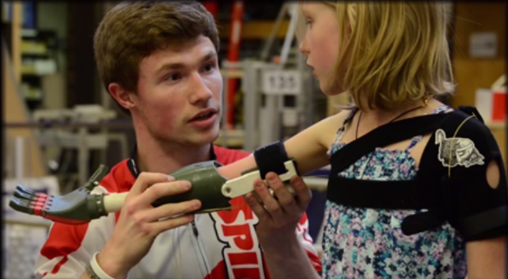
Examples: Focus on improving lives

Slide 14

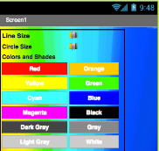
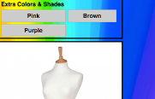
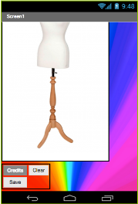
Examples: Focus on student interests
Notes:
These are 7th graders in Introduction to Computer Science in Norwalk, CA. They created a fashion designer.

Slide 15

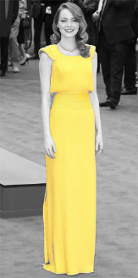




Examples: Focus on student creativity

Slide 16
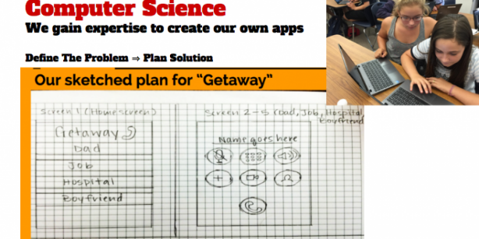
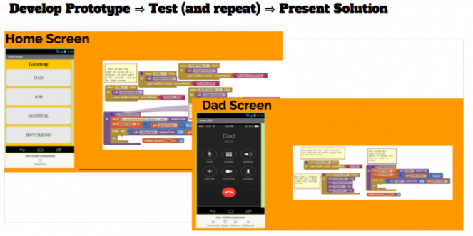
Examples: Focus on student’s needs
Notes:
These middle school students designed an app to get them out of uncomfortable social situations. Note the documentation, which includes prose on other pages.

Slide 17
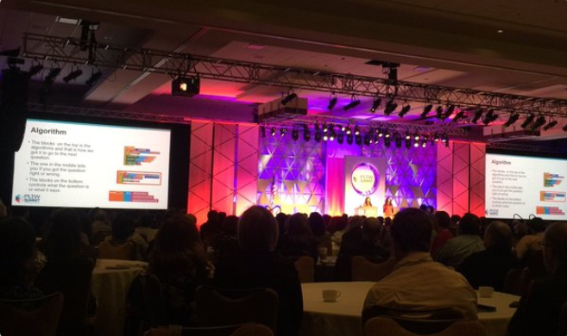
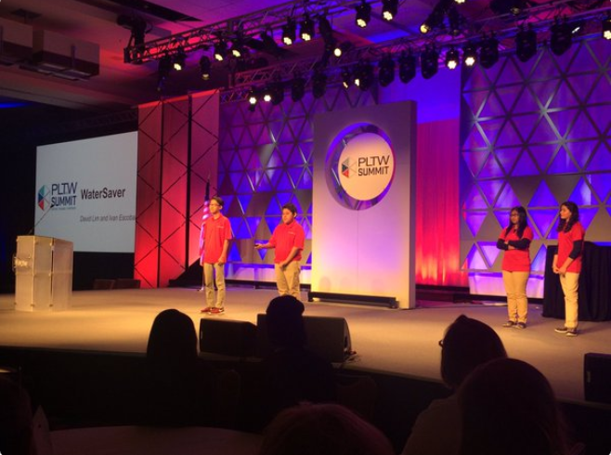
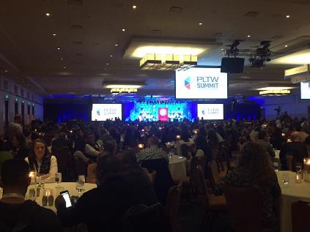
Examples: Focus on making the world a better place
Notes:
These pictures are from the PLTW Summit in March in Indianapolis. About twenty students presented various apps to an audience of 1800 people.
[Advance animation] The four middle schoolers that you just saw up on the stage in front of those 1800 people are talking about an app they created so that individuals could help solve the California draught and could share data to make it social.

Slide 18
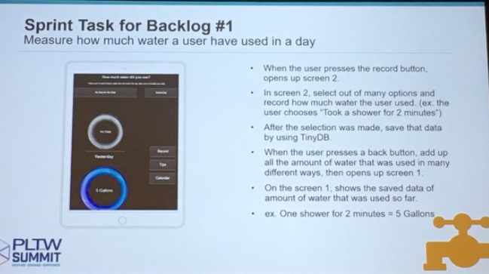
Examples: Focus on making the world a better place
Notes:
These pictures are from the PLTW Summit in March in Indianapolis. About twenty students presented various apps to an audience of 1800 people.
[Advance animation] The four middle schoolers that you just saw up on the stage in front of those 1800 people are talking about an app they created so that individuals could help solve the California draught and could share data to make it social.

Slide 19
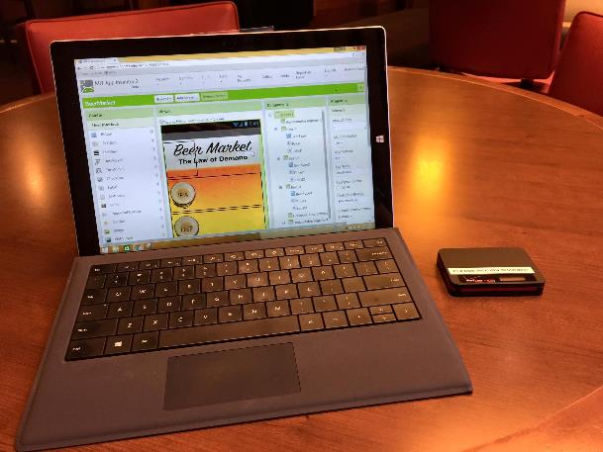
Examples: Focus on participant teachers’ interests

Slide 20
Problem-based AP® CS Principles
Part I: Problem-based learning (15 min)
Part II: Game Theory Simulation (70 min)
Break (10 min)
Part III: Genomic Data (65 min)
Q&A (10 min)

Slide 21
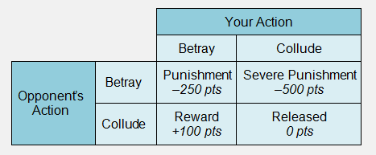
CSP Lesson 1.3: Algorithms in Python Project 1.3.10 Game Theory

Slide 22
Problem-based AP® CS Principles
Part I: Problem-based learning (15 min)
Part II: Game Theory Simulation (70 min)
Break (10 min)
Part III: Genomic Data (65 min)
Q&A (10 min)

Slide 23
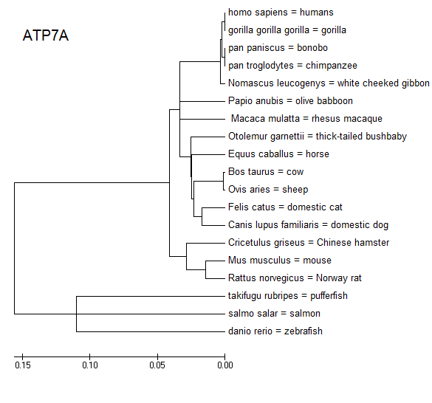
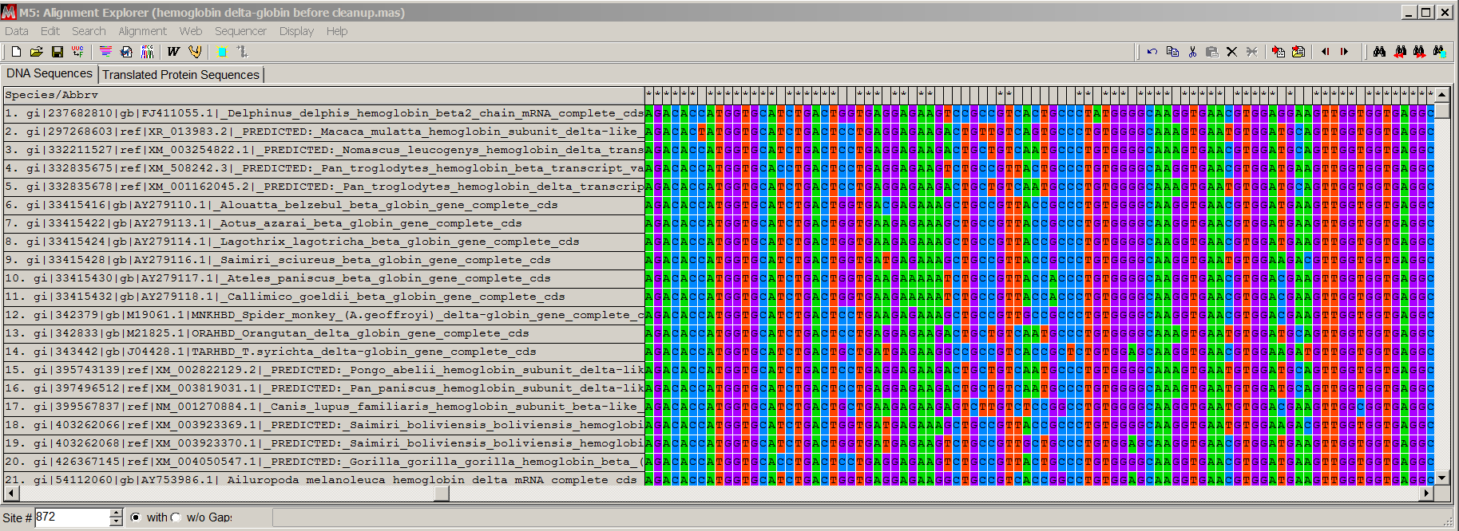
CSP Lesson 3.2 Visualize Data

Slide 24
CSP Lesson 3.2.6 Genomic Data
Procedure
In this project you will use computational power to:
Search a protein database for keywords and retrieve the encoding human (Homo sapiens) DNA sequence
Find DNA sequences in other species that are similar to Homo sapiens DNA sequence for that protein
Align the various species’ DNA sequences
Build a tree that shows relationships between species with similar DNA sequences

Slide 25
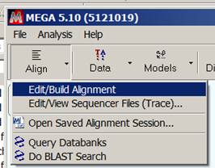
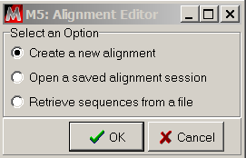
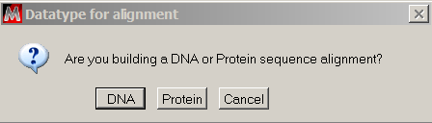
CSP Lesson 3.2.6 Genomic Data: Step 3a
Search a protein database for keyword to retrieve a human DNA sequence, as follows.
In MEGA, Choose Align > Edit/Build Alignment. Choose to Create a new alignment in the dialog box, and select DNA for the datatype. This will open a second MEGA window, the MEGA Alignment Explorer.

Slide 26
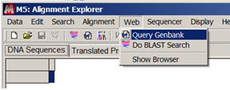
CSP Lesson 3.2.6 Genomic Data: Step 3b
Search a protein database for keyword to retrieve a human DNA sequence, as follows.
In the MEGA Alignment Explorer, choose Web > Query Genbank. This will open a third MEGA window, the MEGA Web Browser. The browser will already be directed to a search page at the National Center for Biotechnology Information (NCBI), an agency of the U.S. government within the National Institutes for Health (NIH). NCBI is in charge of GenBank, a repository of DNA sequences published by scientists. As of 2013, it contains over 160 million DNA sequences totaling over 150 billion base pairs.

Slide 27
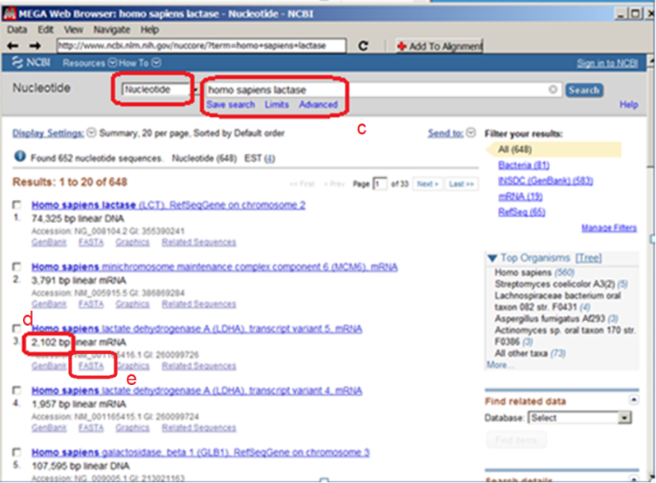
CSP Lesson 3.2.6 Genomic Data: Step 3c
Search a protein database for keyword to retrieve a human DNA sequence, as follows.
On the NCBI webpage in the MEGA Web Browser, enter ‘homo sapiens’ and the name of a human protein in the search box, as shown in ‘c’ in the figure below. Note that you are searching for nucleotide sequences tagged with these keywords. You can use any human protein; some are suggested on the Project 3.2.6 Supplement A: Human Proteins. Use the all capital-letter symbol for the protein from the protein’s Wikipedia page as shown in the figure below.

Slide 28
CSP Lesson 3.2.6 Genomic Data: Steps 3d-e
Search a protein database for keyword to retrieve a human DNA sequence, as follows.
If one of the sequences seems like the protein you were looking for, check the length of the DNA sequence in basepairs, as shown in ‘d’ in the figure above. You want a result that is around 500-2000 basepairs; shorter sequences will match too many sequences from other species, and longer sequences will take too much computation to align with other sequences in the time you have. You also want a result that is mRNA.
Select the FASTA file for your sequence. See ‘e’ in figure above.

Slide 29
CSP Lesson 3.2.6 Genomic Data: Step 3f
Search a protein database for keyword to retrieve a human DNA sequence, as follows.
The MEGA Web browser will navigate to the webpage for this DNA sequence that has been uploaded by the scientist(s) who collected the DNA sequence data. Copy the NCBI reference number for this sequence, as noted with the red box, by shift-click highlighting it from beginning to end, and using Ctrl-C or Edit>Copy to copy the string into the clipboard.

Slide 30
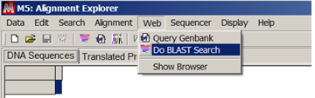
CSP Lesson 3.2.6 Genomic Data: Step 4a
In this step you will use one of the most important algorithms in biology: the Basic Local Alignment Search Tool (BLAST). The BLAST algorithm takes one sequence of DNA and finds matching DNA amongst billions of other sequences. BLAST was invented in 1990 by five people at NCBI and at the Computer Science departments at Penn State and the University of Arizona. You will run the BLAST algorithm on high-speed computers at NCBI. It will take a few minutes because you are sharing those computers with the world’s scientists. The algorithm will return to you the most closely matching sequences among the ~1 billion sequences in the NCBI database. Some of the database’s sequence are entire chromosomes, millions of base pairs long, but many are “expressed sequence tags,” the sequence of mRNA that has been made in the nucleus and gets exported to the ribosomes for translation into protein.
In the MEGA Alignment Explorer, choose Web > Do BLAST Search. This will open another MEGA Web Browser window, already directed to the BLAST entry page at NCBI.

Slide 31
CSP Lesson 3.2.6 Genomic Data: Step 4b
Choose tblastx as shown in ‘b’ in figure below. The tblastx option takes a DNA sequence you provide, translates it to protein, and uses the BLAST algorithm to search for protein sequences that align with the one you give, translated from DNA sequences in the database. You can set the translation code; we’ll search based upon the standard genetic code for nuclear DNA; mitochondria use a slightly different code.

Slide 32
CSP Lesson 3.2.6 Genomic Data: Step 4c
As shown in ‘c’ in the figure above, paste the accession number from step 3f into the FASTA sequence window; BLAST will use the sequence corresponding to this accession number as your “query” sequence.

Slide 33

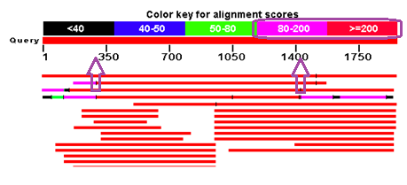
CSP Lesson 3.2.6 Genomic Data: Steps 4d-e
Click the BLAST button at the bottom of the page. The algorithm is running on NCBI’s very fast computers, but it could take 5 or 10 minutes.
Take a screenshot of the Graphic Summary of your alignment results and paste it below the example here. The example here has three purple annotations used in the template below. Each horizontal bar represents one search result subject. The color coding shows the extent and quality of the result’s alignment with your query DNA sequence; red regions have the best alignment. Pick one result from your screenshot and explain the representation of the horizontal bar to your partner, using the following example as a template:
“In the example results shown above, the fourth result aligns with the entire DNA sequence we provided, but only aligns well (score>=200) from base ~300 to base ~1450.” Your partner will pick another result to explain to you. Record both of your explanations along with your screen shot here.

Slide 34
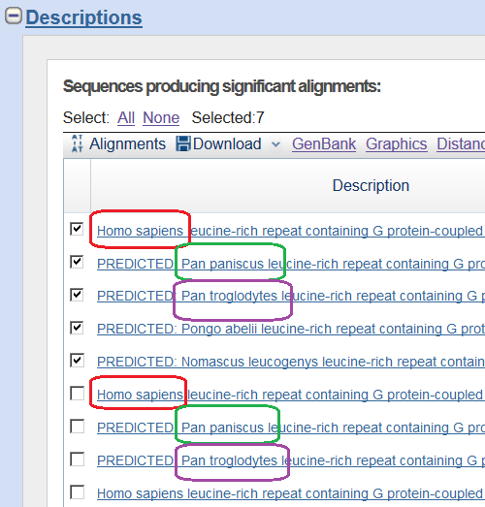
CSP Lesson 3.2.6 Genomic Data: Step 4f
Now look at the Descriptions section of the BLAST report. “Predicted” means that the scientist that submitted the DNA is only predicting what the protein does in the organism based on what a similar protein does in another organism. For each species that appears, select the checkbox of the highest scoring “mRNA” result. Do not worry about the “predicted” notation, since we’re only going to be using the fact that the DNA is in the organism.

Slide 35
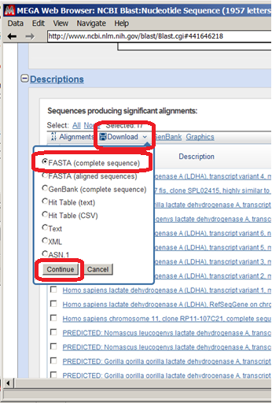
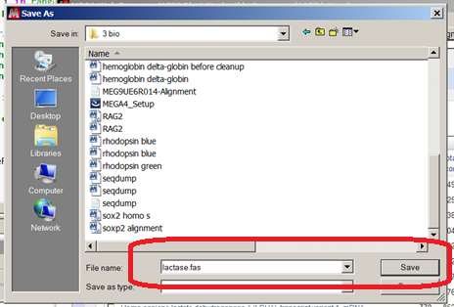
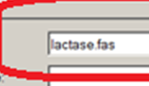
CSP Lesson 3.2.6 Genomic Data: Step 4g
Download the selected results, using FASTA format for the complete sequence. Save the file using the name of your protein. Type .fas for the file extension.

Slide 36
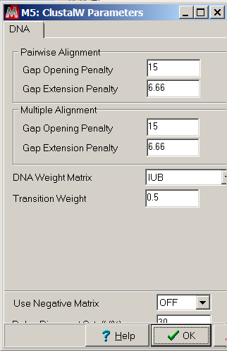
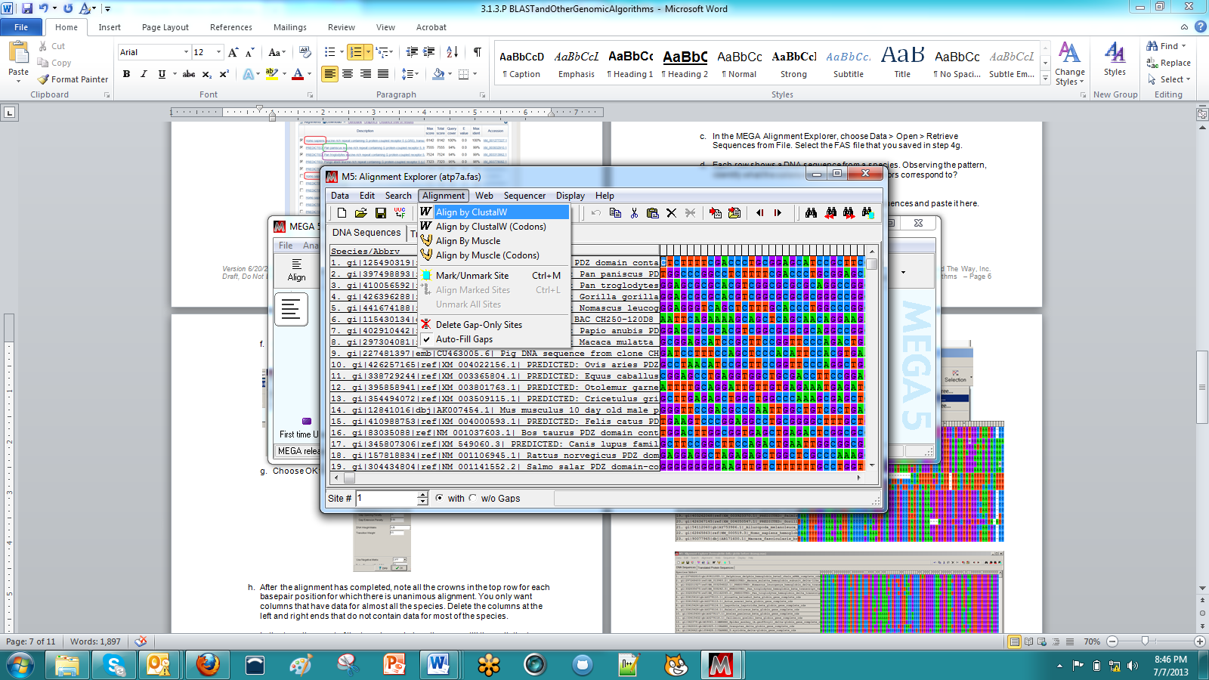
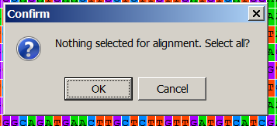
CSP Lesson 3.2.6 Genomic Data: Steps 5c-g
In this step, you will use your computer to align the sequences you downloaded. You will use the ClustalW algorithm, which is much slower but more accurate than BLAST.
In the MEGA Alignment Explorer, choose Data > Open > Retrieve Sequences from File. Select the FAS file that you saved in step 4g.
Each row shows a DNA sequence from a species. Observing the pattern, identify what the colors mean. What do the colors correspond to?
Take a screenshot of this unaligned list of sequences and paste it here.
In the MEGA Alignment Explorer, choose Alignment > Align by ClustalW. Choose OK to select all when prompted.
Choose OK to accept defaults for ClustalW parameters.

Slide 37
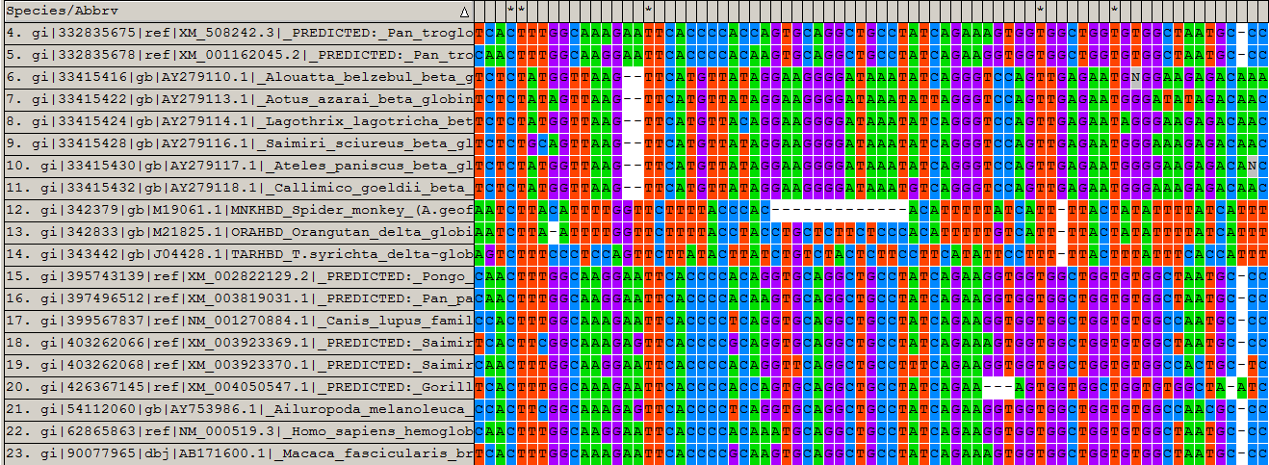
CSP Lesson 3.2.6 Genomic Data: Step 5h
After the alignment has completed, note all the crowns in the top row for each basepair position for which there is unanimous alignment. You only want columns that have data for almost all the species. Delete the columns at the left and right ends that do not contain data for most of the species. The two windows shown below are alignments of a group of sequences. In the top window, it looks like the group of sequences has four subgroups that each have an aligned pattern. Notice that the first and fourth subgroups are actually aligned with each other; the interface allows you to drag rows to help visually organize the alignment. The second alignment window shown below is ready to be used to calculate a phylogenetic tree; you do not need the entire gene to be aligned. You should be able to create a good alignment across all the species you used across the overlapping regions of alignment indicated in the Graphic Summary of BLAST results from Step 4e.

Slide 38
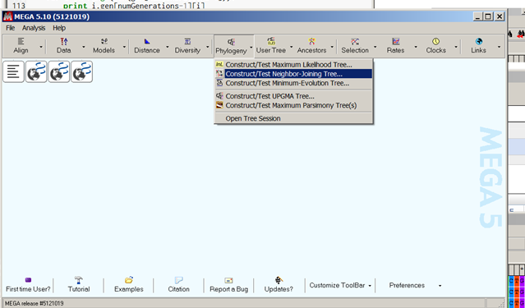
CSP Lesson 3.2.6 Genomic Data: Steps 5i, 6a
In this step, you will use your computer to align the sequences you downloaded. You will use the ClustalW algorithm, which is much slower but more accurate than BLAST.
Export your alignment as a MEGA file so that you can use it with another algorithm by choosing Data > Export Alignment > MEGA format. Name the data by the protein you used. Select “Yes” when asked if these are protein-coding data.
Now you will use another algorithm in MEGA: the nearest-neighbor joining algorithm for making a tree
In the MEGA main window, choose Phylogeny > Construct/Test Neighbor-Joining Tree. Select your file.

Slide 39
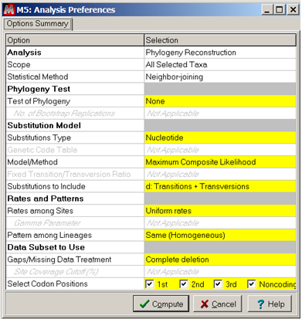
CSP Lesson 3.2.6 Genomic Data: Step 6b
Now you will use another algorithm in MEGA: the nearest-neighbor joining algorithm for making a tree
In the resulting dialog box, choose Compute and accept all of the default Analysis Preferences. This will open another window, the MEGA Tree Explorer.

Slide 40
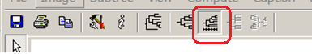
CSP Lesson 3.2.6 Genomic Data: Steps 6c-d
Now you will use another algorithm in MEGA: the nearest-neighbor joining algorithm for making a tree
The Compute Linearized Tree button can be used to toggle whether horizontal lengths are proportional to genetic change.
Using the snipping tool and paint, the tree can be annotated with species’ common names from the Project 3.2.6 Supplement B: List of Mammals.

Slide 41

CSP Lesson 3.2.6 Genomic Data: Conclusions
Generalize the relationships shown in your phylogenetic tree. What groupings and relationships between groupings do you observe? There is an additional tree shown here, and there are two more at the end of the conclusion questions.
Exchange trees with one or more other groups. Explain your tree to the other groups, and have other groups explain their phylogenetic trees to you. What similarities and differences do you observe among the trees?
One of the trees shown here is for ATP7A, a protein used to transport copper in the body. The horizontal distance shown to the right of the division of cows and sheep is less than the horizontal distance shown after the division of cats and dogs. What does this distance indicate about the results of this calculation?

Slide 42

Algorithmic problem of alignment Tying it all together
CSP.EK4.2.4F: Finding an efficient algorithm for a problem can help solve larger instances of the problem.
Notes:
GitHub calculates the differences between two files to show a diff. BLAST calculates the similarity between two strings of nucleotides GCAT. MEGA executes other algorithms that are more accurate for aligning two DNA sequences. The human occipital lobe is even better, so MEGA presents the problem to you by color coding nucleotides. This sentence is Word with track changes shows a deletion and an insertion, but there is not a straightforward algorithm for deciding which parts of two files align with other in order to determine deletions and insertions. Solving an algorithmic problem in one context often solves the problem in a more general context of an abstracted problem. CSP.EK4.2.4F: Finding an efficient algorithm for a problem can help solve larger instances of the problem.

Slide 43
Problem-based AP® CS Principles
Part of a problem-based K-12 pathway
https://github.com/PLTWCS/csta2016
Questions and Discussion
Bennett Brown, Project Lead The Way
bennettbrowniowa@gmail.com tweet@bennettbrownia
Maurine Neiman, University of Iowa
maurine-neiman@uiowa.edu tweet@mneiman
Scott Sanicki, GitHub
education.github.com/contact tweet@githubeducation

Slide 44
References
Boss, S. (2015). PBL for 21st Century success: Teaching critical thinking, collaboration, communication, and creativity. Buck Institute for Education: CA.
Hattie, J. (2009). Visible learning: a synthesis of over 800 meta-analyses relating to achievement. Routledge: NY.
Kumar, S. Stecher, G. and Tamura, K. (2016). “MEGA7: Molecular Evolutionary Genetics Analysis Version 7.0 for bigger datasets,” Molecular Biology and Evolution. 33:1870-1874.
Wiggins, G. and McTighe, J. (2011). The Understanding by Design guide to creating high quality units. ASCD: VA.

